Slide 1
LOST &
FOUND
BING NEWS VERTICAL
MOBILE DESIGN EXPLORATION
MENTOR YAN YAN
YIFEI GONG SEPTEMBER 2019

Slide 2
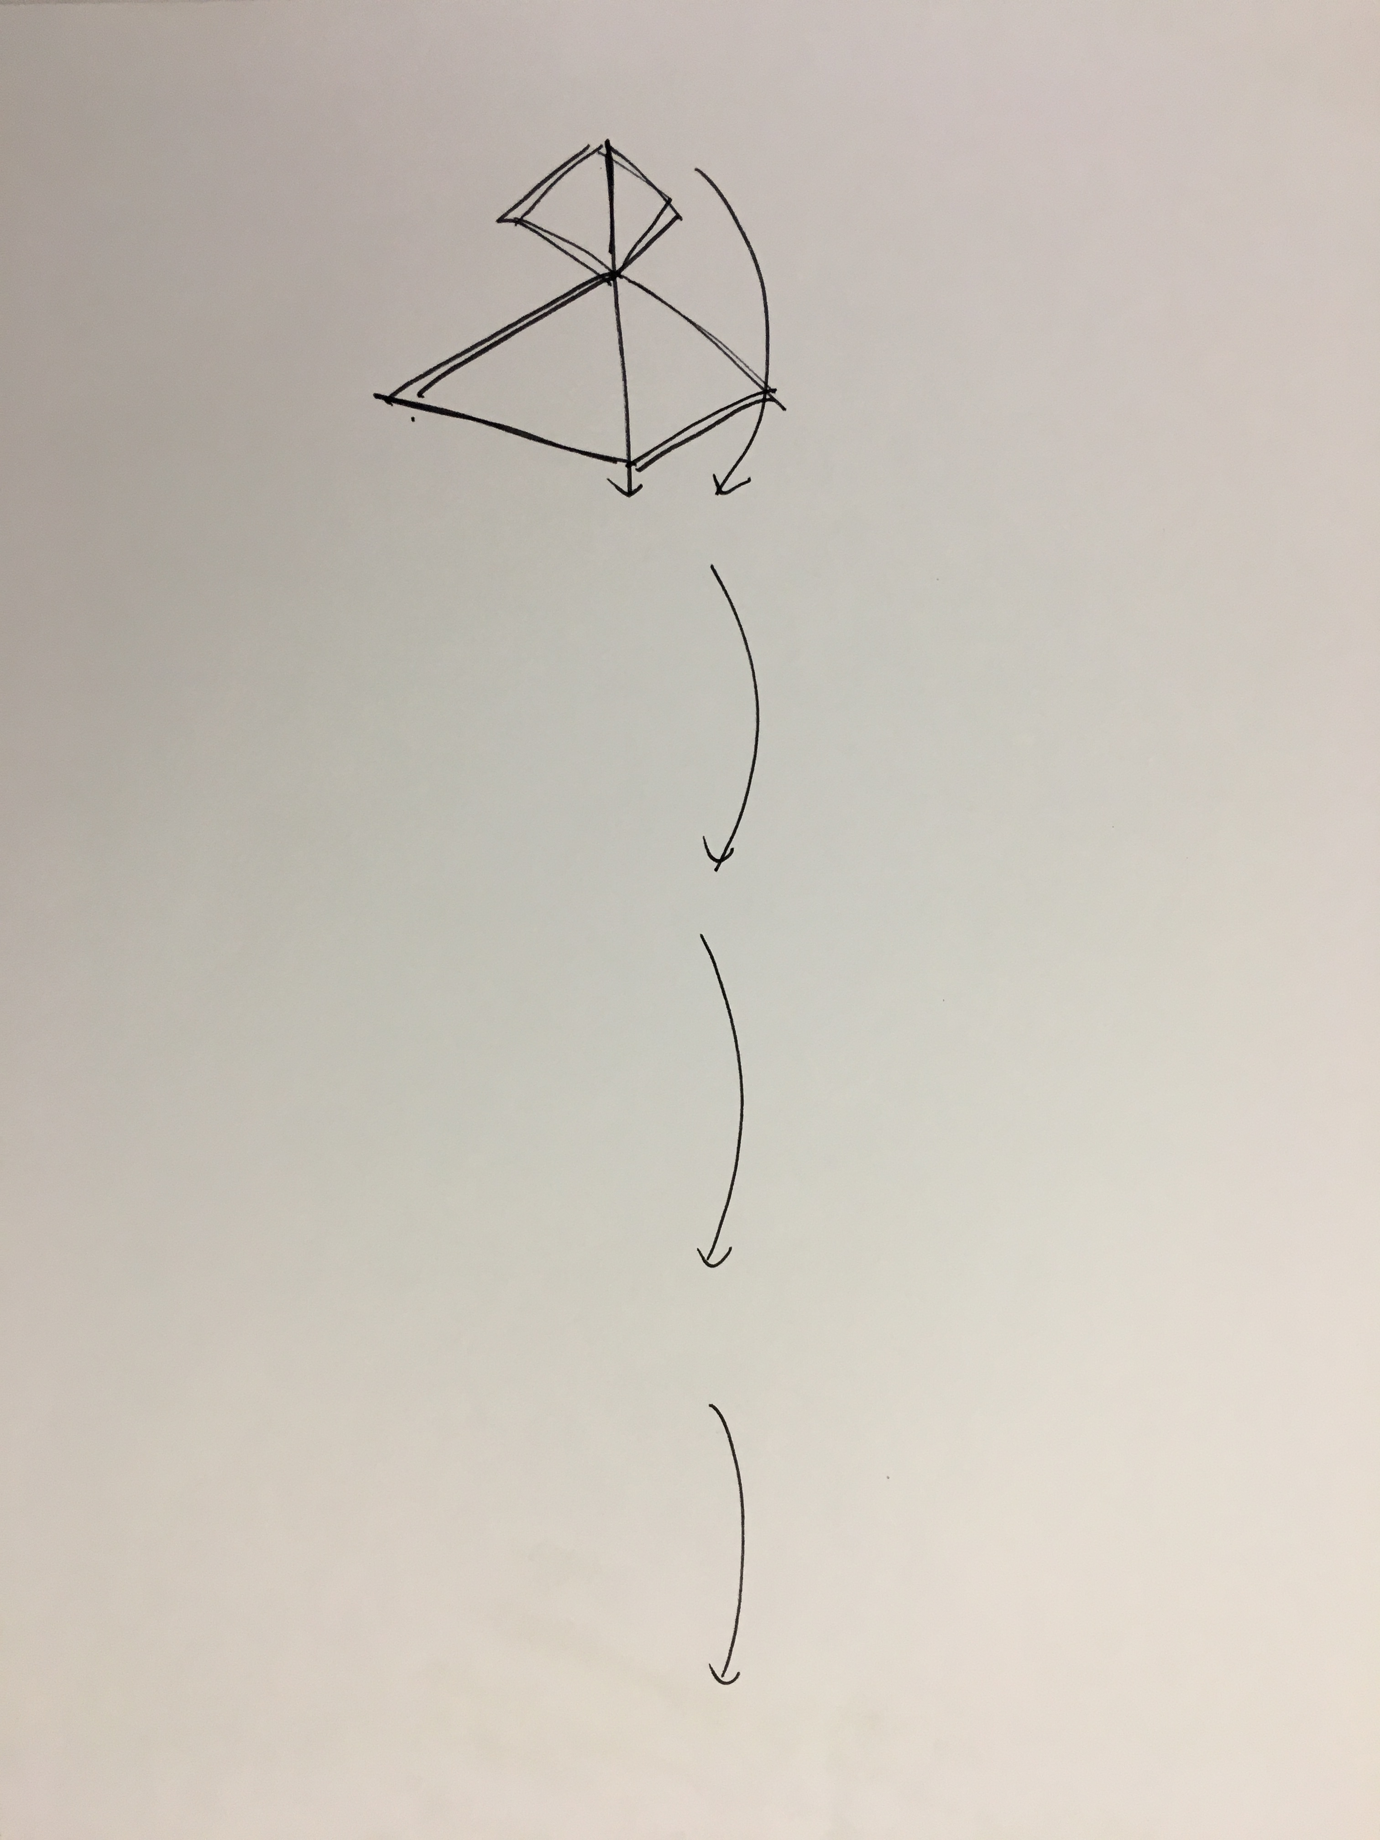
Internship flashback

Slide 3
My Initial goal
Bing News Vertical
Mobile Design
Notes:
So I’m going to unpack each current pain point and solution one by one.
The first one is lost focus which brought by long reading list, quick scrolling down and view the content in a same pattern.
People’s perception is getting flatten.

Slide 4
Common sense
NEWS=BREAKING
Notes:
Starting point

Slide 5
Actual feedback
READ NEWS=BORING
Notes:
News is a breaking image in common sense. But when people talking about is, people feel like reading news is boring.

Slide 6
Unmeted PAIN POINTS
Lost Interest
Hard to get personalized content
Lost Focus
Lost focus while reading
Lost Update
Hard to catch-up since last time read
Notes:
The reasons behind it through my research are while reading new, lost focus, lost interest an lost update make them feel actively reading news is boring.

Slide 7
LOST
Notes:
Lost is certainly a passive word to describe the current experience.

Slide 8
FOUND
Opportunity AREA
Notes:
And the solutions I’ve explored are around Found.

Slide 9
Showcase example
For You
Notes:
And the solutions I’ve explored are around Found.

Slide 10
PAIN POINT 1
LOST INTEREST
Feel the content is not attracting
Notes:
But there is another part of this problem, why people lost their focus on our design, may be they couldn’t find the topics they are interested in.

Slide 11

Barrier
Mobile news app users say they want personalized content, but few have taken steps to get it.
Mobile News Apps Survey Results, June 2017
Notes:
What could attract their focus?

Slide 12
Personalize For You Content on Mobile
Scenario

Slide 13
Make personalization on mobile easier and more accessible
HMW

Slide 14
DESIGN DIRECTION
Content Personalization
Notes:
But there is another part of this problem, why people lost their focus on our design, may be they couldn’t find the topics they are interested in.

Slide 15
Signed-in on Mobile
Browse News on Mobile
Personalize on Desktop
Back to Mobile and View

Slide 16
Personalize on Desktop
MOBILE SCENARIO
Signed-in on Mobile
Browse News on Mobile
Back to Mobile and View

Slide 17
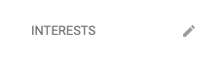
CURRENT DESIGN
Only on desktop, they could manage their interest.

Slide 18
User’s Expectation
People want easier, more immediate ways to personalize their feed to make it more useful and engaging.
Mobile News Apps Survey Results, June 2017
Notes:
What could attract their focus?

Slide 19
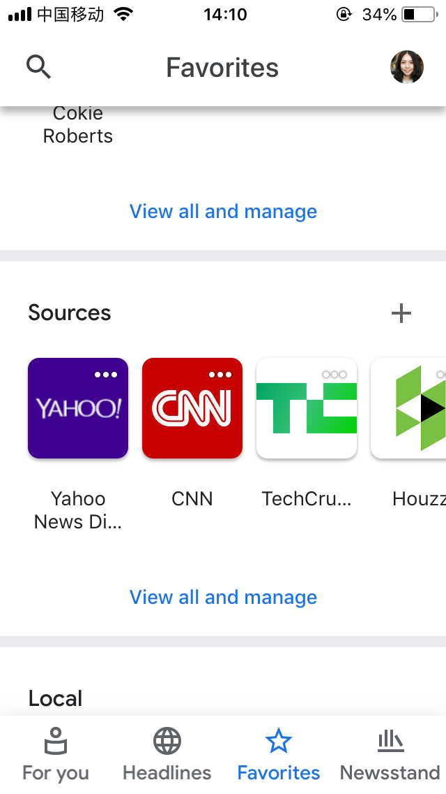
Competitor
Google
2 Tabs
Various dimension to fit user’s mental model of content category

Slide 20
Personalize on Desktop
MOBILE SCENARIO
Signed-in on Mobile
Browse News on Mobile
Personalize on Mobile
Continue tobrowse
Expected Benefits
Shorter path
No scenario shifting
On time , update in real-time

Slide 21
HABIT FORMATION
Awareness
Understanding
Action
Engagement
Evaluation

Slide 22
Awareness
Understanding
Action
Engagement
Evaluation
HMW make first time knowing that the content on opal is personalize

Slide 23
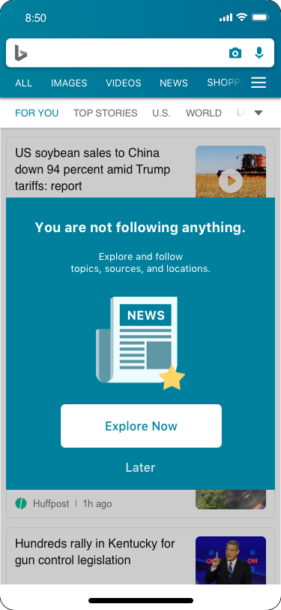
NOT PERSONALIZED POP UP
Have intention to personalize content now
A pop up to let them know they could get personalized content
Show when users follow topic is blank
Tap [discover now] jump to content personalization page
Tap [later] jump close the pop up

Slide 24
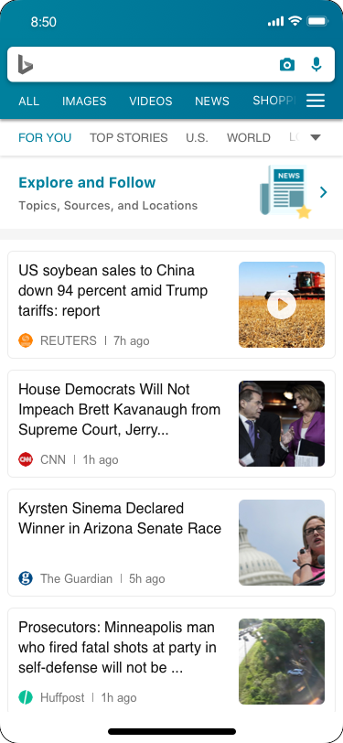
LATER ENTRY POINT
Not have intention to personalize content now
The pop up close and transform to a window on the top of the [for you] page

Slide 25
USER FLOW
Personalization Page
Banner
Personalization Page
Pop up

Slide 26
Awareness
Understanding
Action
Engagement
Evaluation
HMW make a more accessible and visible follow function when uses intent to follow topics
Clear interaction and status indication

Slide 27
Expectation
Users prefer content to be organized by category/topic.
Mobile News Apps Survey Results, June 2017
Notes:
What could attract their focus?

Slide 28
Information Architecture
Topics
Following
Content
Sources
Locations
Not following

Slide 29
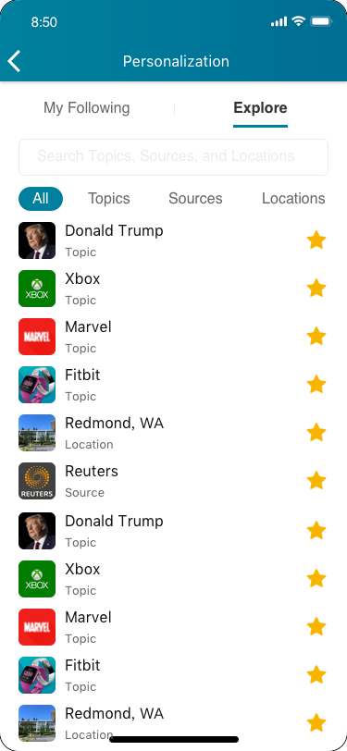
CENTRALIZED PERSONALIZATION PAGE
233

Slide 30
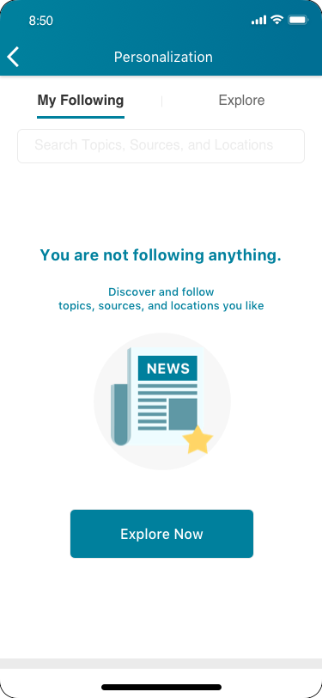
My following
112

Slide 31
USER FLOW

Slide 32
Awareness
Understanding
Action
Engagement
Evaluation
HMW make the for you tab feel more relevant to yo
Taking action on following something

Slide 33
Current solution on mobile
The intention is after deeper understanding then follow this topic
“Fitbit” Search result
Espresso Card
Follow
“Fitbit” Comprehensive view page
Espresso Card

Slide 34
USER ACTIONS
Users actively find :
Intentions
Users have had target topics(existed in their mind) to follow-search
Users passively perceive:
Intentions
See interesting things or be reminded

Slide 35
COMPETITOR ‘S SOLUTION
Flipboard
Fill, recommend
Microsoft news
Fill, recommend
Google News
Search, recommend
Reuters
Fill, Search
Search + recommendations

Slide 36
So make a list
112
Every item has avatar, name, and type

Slide 37
FOLLOW
Star filled
Location keep
For undo

Slide 38
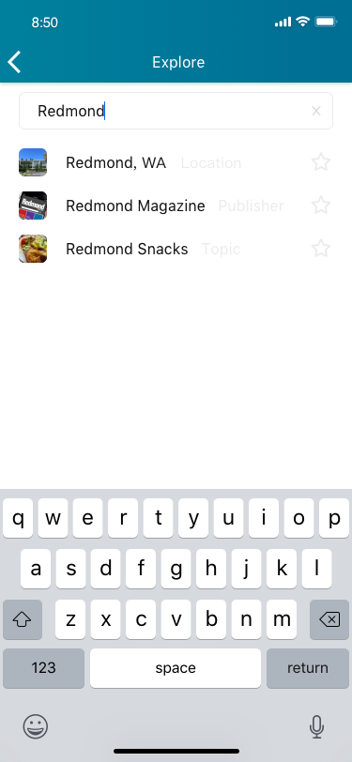
Search
112

Slide 39
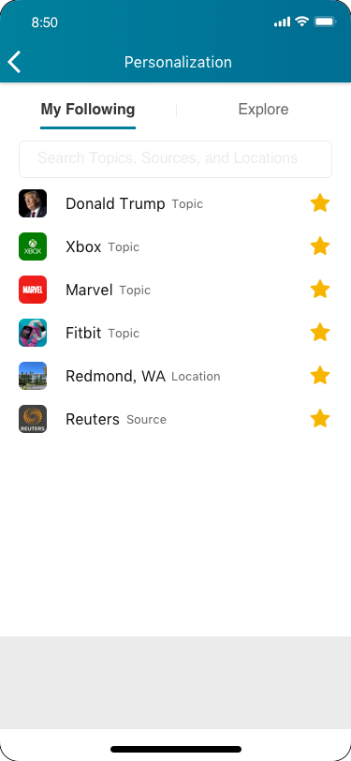
After followed
You can see result immediately in my following
112

Slide 40
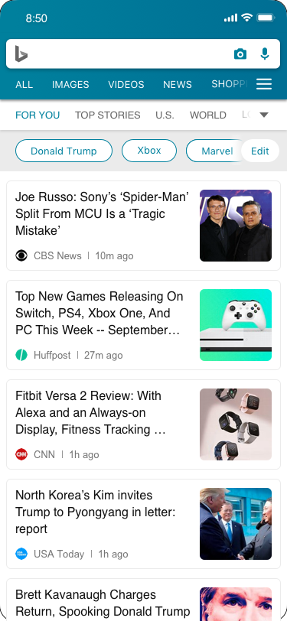
4Engagement
Show
First time

Slide 41
USER FLOW

Slide 42
Awareness
Understanding
Action
Engagement
Evaluation
2333

Slide 43
Engage Content
Objective

Slide 44
CLEAR AND EFFICIENCY
Goal

Slide 45
Only text
Filter
Solution

Slide 46
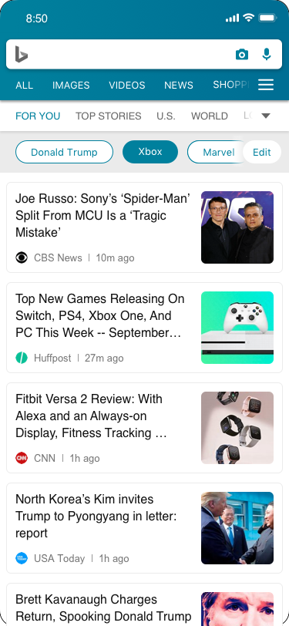
4Engagement
Filter
See result on the current page

Slide 47
PAIN POINT 3
LOST PROGRESS
233

Slide 48
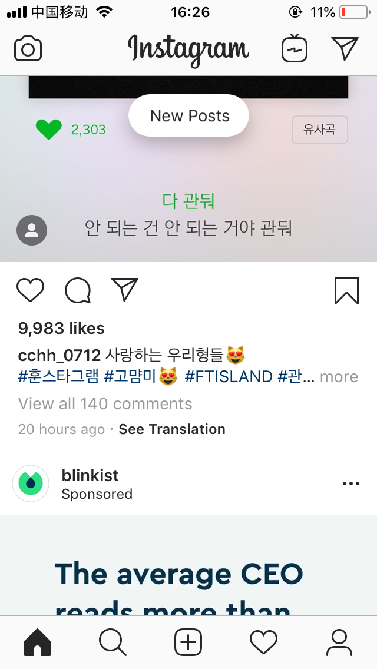
Reuters
COMMON SOLUTION 2
Instagram
A floating button to notify users new posts
Reuters
Tiny refresh notification with number on the top of the category page

Slide 49
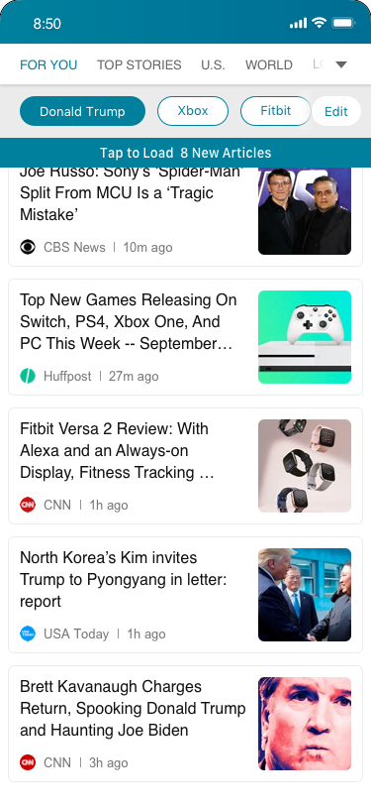
Design 3 refresh notification
On the top of the list area while a certain number of new articles are ready
Show the number of new articles and instructions
Go back to the list top and load the new articles
Search result
Top stories
For you
Category page

Slide 50
Design 3 refresh notification
PROS
Able to know how many new article they could get and how to use this function
CONS
It won’t be triggered if only have a few new articles
Users don’t know the exact content of them, if tap, they also lost the current reading progress

Slide 51
Scenario
Staying up-to-date is the primary reason people use mobile news apps.(1)
Notes:
What could attract their focus?

Slide 52
News keep brewing
Last time read
This time open
New content was generated

Slide 53
Solution 1
Know Updates
When they emerging in a long reading list, while scrolling down, the content is getting not up-to-date.

Slide 54
COMMON SOLUTION 1
Tiny red dot

Slide 55
Not to strong but visible
HMW

Slide 56
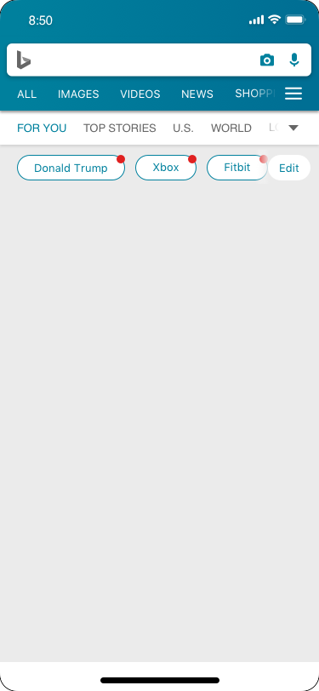
Update red dot
112

Slide 57
Solution 2
Catch Updates
When they emerging in a long reading list, while scrolling down, the content is getting not up-to-date.

Slide 58
Just read
No Updates differentiation
Repeated news
Boring content+ stupide algorithm
Less chance read others
Last time read

Slide 59
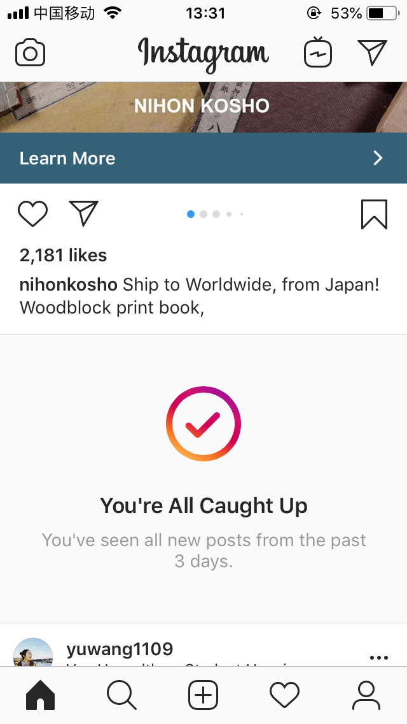
COMPETITORS
Instagram
A section separate read and unread news
LinkedIn
Untappable floating layer

Slide 60
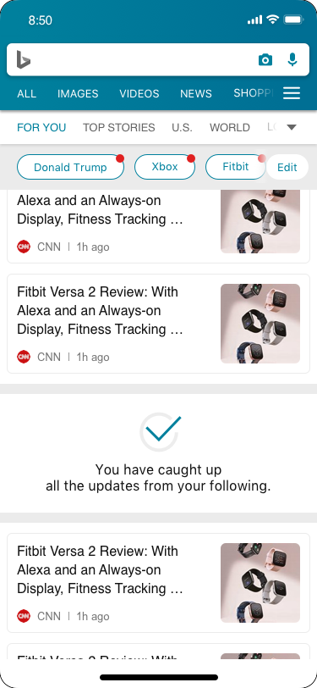
DESIGN CATCH-UP
DESIGN CATCH-UP
Pros
Show up in the list of news (Static)
No need to read article last time they’ve read
Cons
Not like social content digestion, if last time they scroll down really quick, they may skip some important update

Slide 61
PAIN POINT 3
LOST CONTROL
Long reading list with same pattern would make users feel boring
Notes:
So I’m going to unpack each current pain point and solution one by one.
The first one is lost focus which brought by long reading list, quick scrolling down and view the content in a same pattern.
People’s perception is getting flatten.

Slide 62
Awareness
Understanding
Action
Engagement
Evaluation
233

Slide 63
Interest Decrease

Slide 64
Show

Slide 65
Manage order

Slide 66
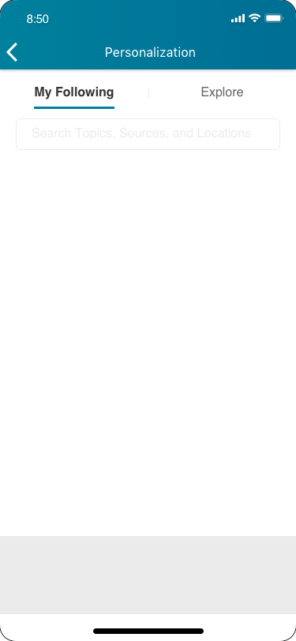
Unfollow Redmond
Keep in the position 误操作

Slide 67

Result-engage

Slide 68
USER FLOW

Slide 69
PAIN POINT 2
LOST FOCUS
Long reading list with same pattern would make users feel boring
Notes:
So I’m going to unpack each current pain point and solution one by one.
The first one is lost focus which brought by long reading list, quick scrolling down and view the content in a same pattern.
People’s perception is getting flatten.

Slide 70
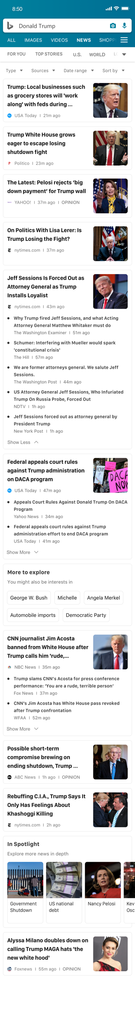
WHEN
While emerging in browsing the news list with some repeated pattern, the perception is getting flattened.
Notes:
Currently
The card in news list is left text, right image
So when you scroll very quick
You could lost focus really easy
Cognitive and vision

Slide 71
Focus
Reading Time
When did they lost focus
Notes:
When do they feel lost

Slide 72
Real-time News ✅
Algorithm Capacity ✅
Feasibility
Notes:
New content is being generated every second.
We have technology to integrate.
What kind of scenario
For example trump’s news is being generated every second
So it has the quantity

Slide 73
Focus
Reading Time
When did they lost focus
Notes:
When do they feel lost

Slide 74
Focus
Fill new
Reading Time
When did they lost focus
Notes:
When do they feel lost

Slide 75
What could attract them?
74% of mobile news app users expect real-time content updates.
Mobile News Apps Survey Results, June 2017
Notes:
What could attract their focus?

Slide 76
Let users know
What happened just now on this topic
HMW

Slide 77
CURRENT WORKAROUND
Refresh the list
Doesn’t have a home button
Users should at least go back to the first screen to refresh by tapping the top bar or manually going back.

Slide 78
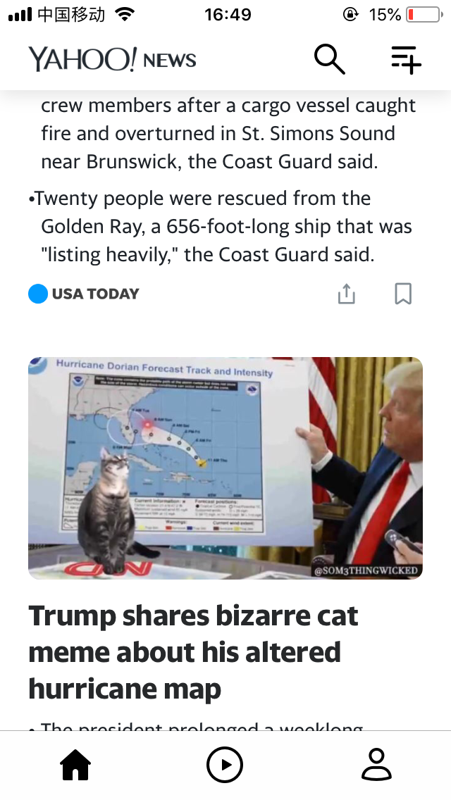
COMMON SOLUTION 1
Quick double tap home button

Slide 79
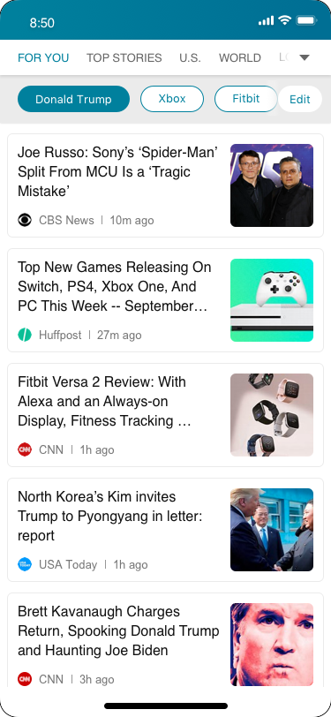
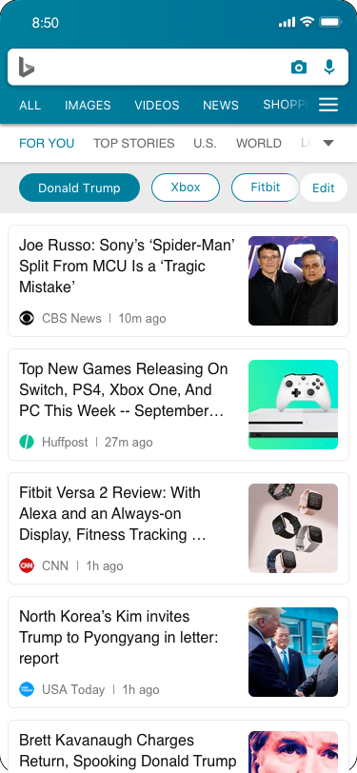

Slide 80
Design 1 quick refresh
On the left bottom corner
Show it when users scroll up quickly
Go back to top and refresh the current page after tapping it
Search result list
Top stories
For you
Category page
Topic page

Slide 81

Design 1 quick refresh
PROS
No distract or attract people actively refresh since it’s triggered by action
Left corner is more useful ergonomically
CONS
May not be able to get new result

Slide 82
OVERALL USER FLOW

Slide 83
FOUND
Interesting content
Realtime content
Unread content
Notes:
And the solutions I’ve explored are around Found.

Slide 84
Internship Wrap up
Other Explorations
233

Slide 86
Alignment on different ends
Native and web interaction
Benefits and efforts balance
Reflections

Slide 87
Appreciate helps from
Yan Yan, Liyuan, Tang
Bing Team
Studio 8

